Slide 1

CAP
Cryptographic Analysis Program
General Help Presentation
Press Enter or click on your mouse button to continue

Slide 2
What is CAP?
CAP is a general purpose tool for the study of classical (and some contemporary) ciphers
CAP is really three related programs in one
  a program that will encrypt and decrypt text using your choice of several algorithms
  a set of tools for breaking unknown ciphers
  a game which will generate random ciphers and challenge you to break them
This presentation will introduce you to the general features of CAP

Slide 3












Contents
Click on the items below to jump to help on the specific topic
  Or just continue to advance through this presentation

Slide 4
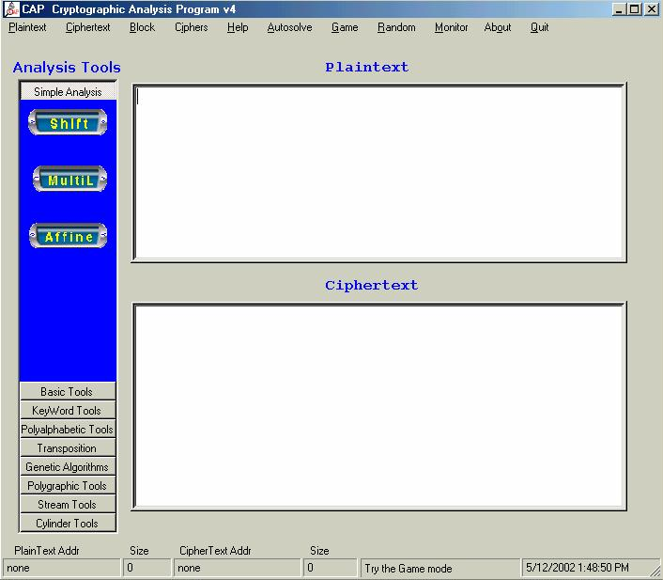

Main Window
When you first open CAP this is the main window:
Enter
Plaintext
Enter
Ciphertext

Slide 5
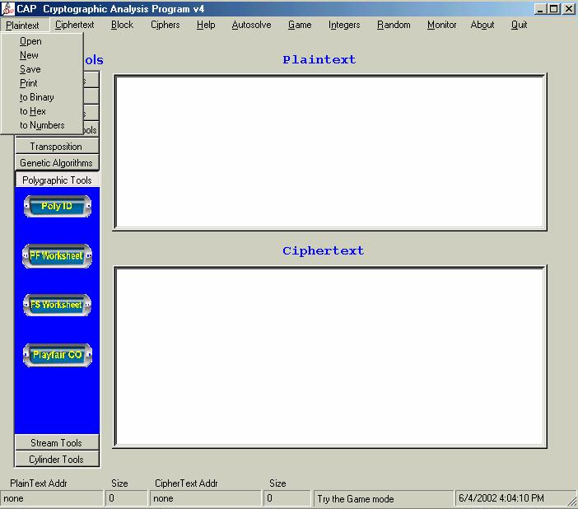
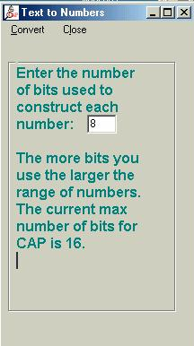
Plaintext Menu
The plaintext menu
allows you to open,
save, print, or convert
the plaintext
Convert to
ASCII
Converting to
numbers is useful
for a variety of
ciphers

Slide 6

Ciphertext Menu
The ciphertext menu
allows you to open,
save, print, or convert
the ciphertext

Slide 7
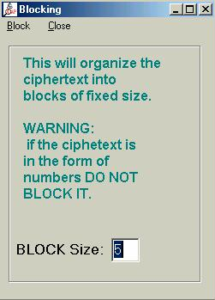
Block Menu
Blocking is the process of separating the ciphertext into segments of fixed size.
  This makes it easier to read without giving away standard word spacing
CipherText without spacing
ppnzyklttekwpovbzy
uioittnbzyqaceeropi
Select Block from
Main Menu Bar
CipherText with blocking
ppnzy kltte kwpov bzy
uioit tnbzy qacee ropi

Slide 8
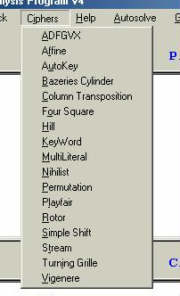
Ciphers Menu
The Ciphers Menu lists all the possible algorithms which CAP is capable of running
  More are being added all the time
  To implement a cipher, click on
  its name in the list
Additional Help on each cipher
is available from the main help screen
or from the help feature of each
individual cipher

Slide 9
Autosolve Menu
Autosolve is not active at this time . . .

Slide 10
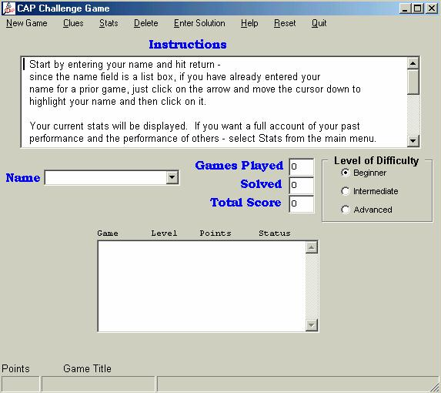
Game Menu
CAP will challenge you with random ciphers
  Select the Games menu
  option
  The instructions on the screen
  and the game help feature
  will explain the details of
  playing against CAP

Slide 11
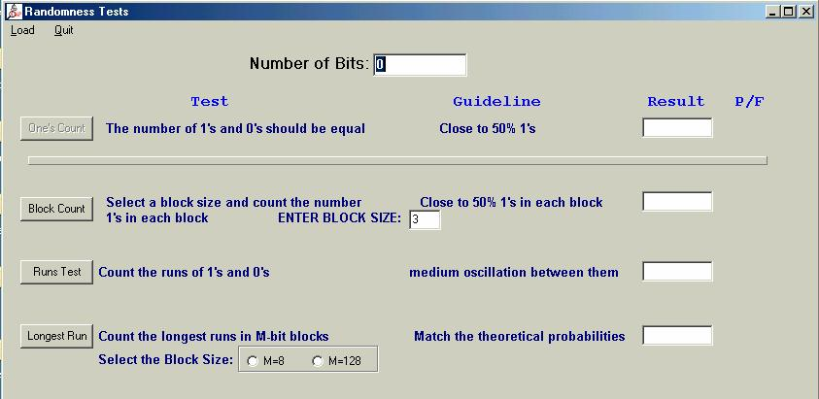
Random Menu
CAP will run standardized randomness tests against binary strings

Slide 12
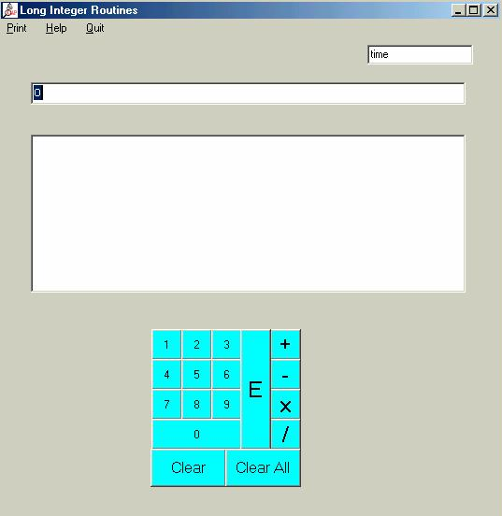
Integers Menu
CAP provides a tool for long integer arithmetic

Slide 13
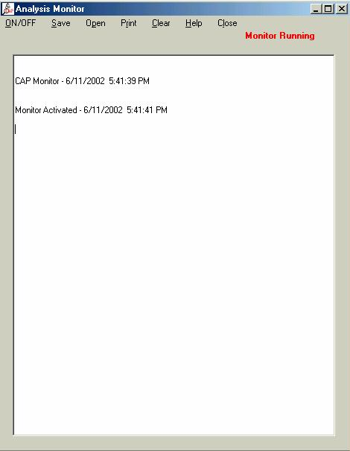
Monitor Menu
CAP can monitor your code breaking activities and provide a record of your use of other tools
  It may help you avoid redoing tests

Slide 14
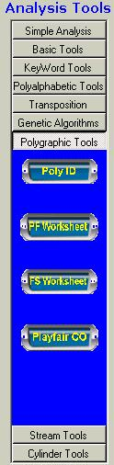
Analysis Bar
The Analysis Bar offers tools than may prove useful in breaking ciphers

